Slide 1



Third Party Integration “To improve the life of the small business customer”

Slide 2



Slide 3
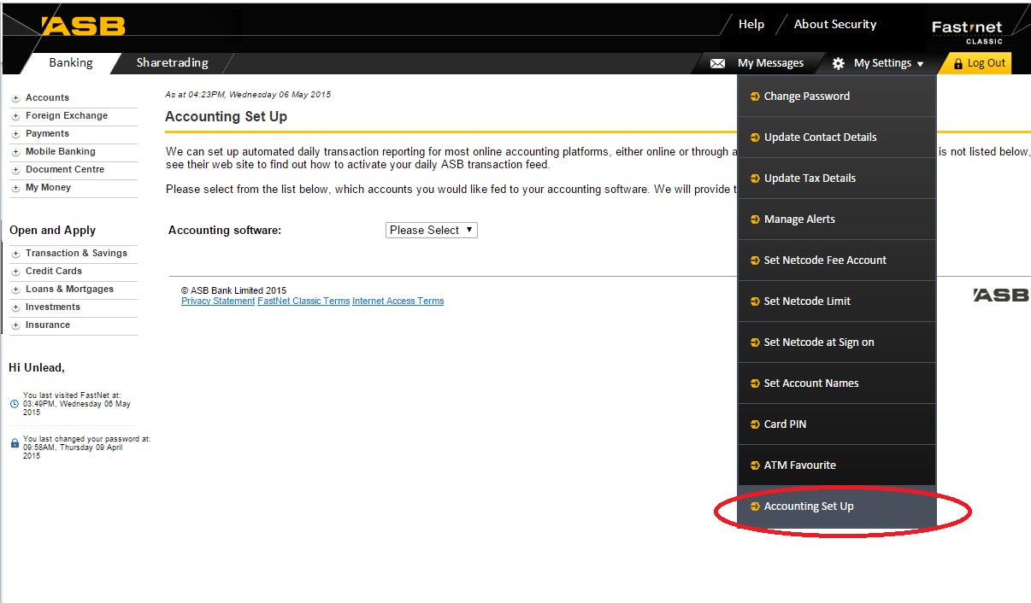
Accounting Set Up (FNB & FNC)

Slide 4
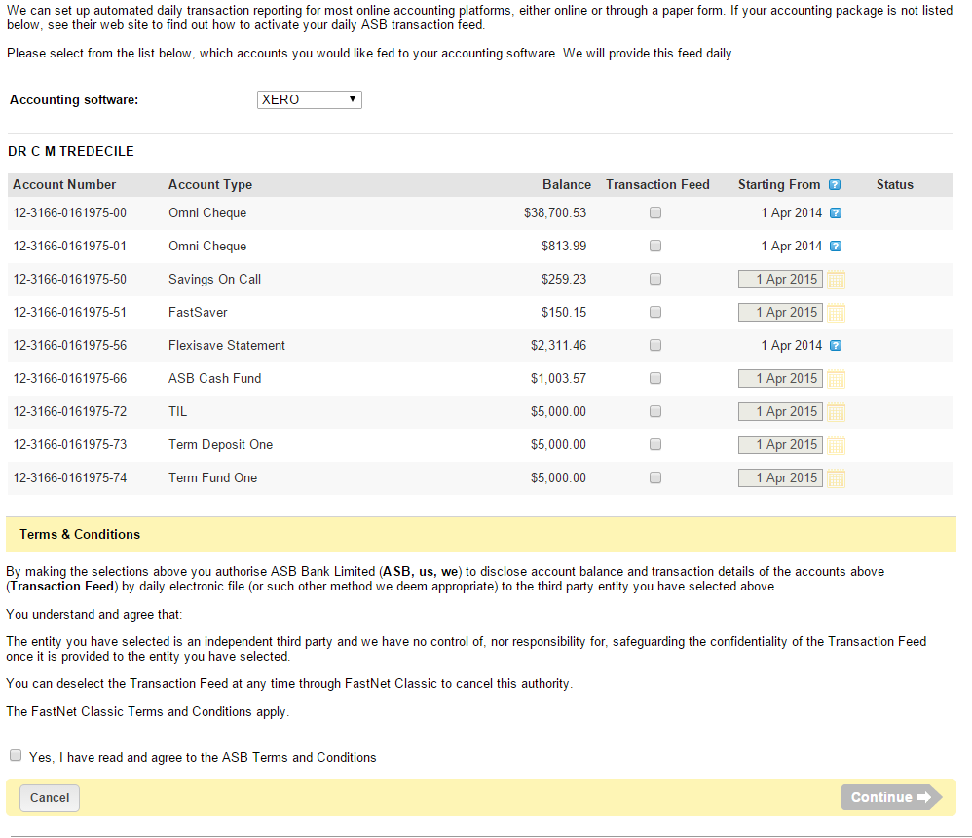
Accounting Set Up – Xero\MYOB

Slide 5
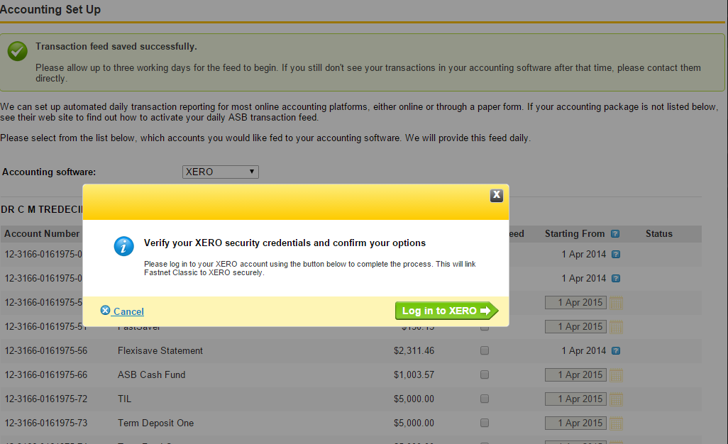
Accounting Set Up – Xero

Slide 6
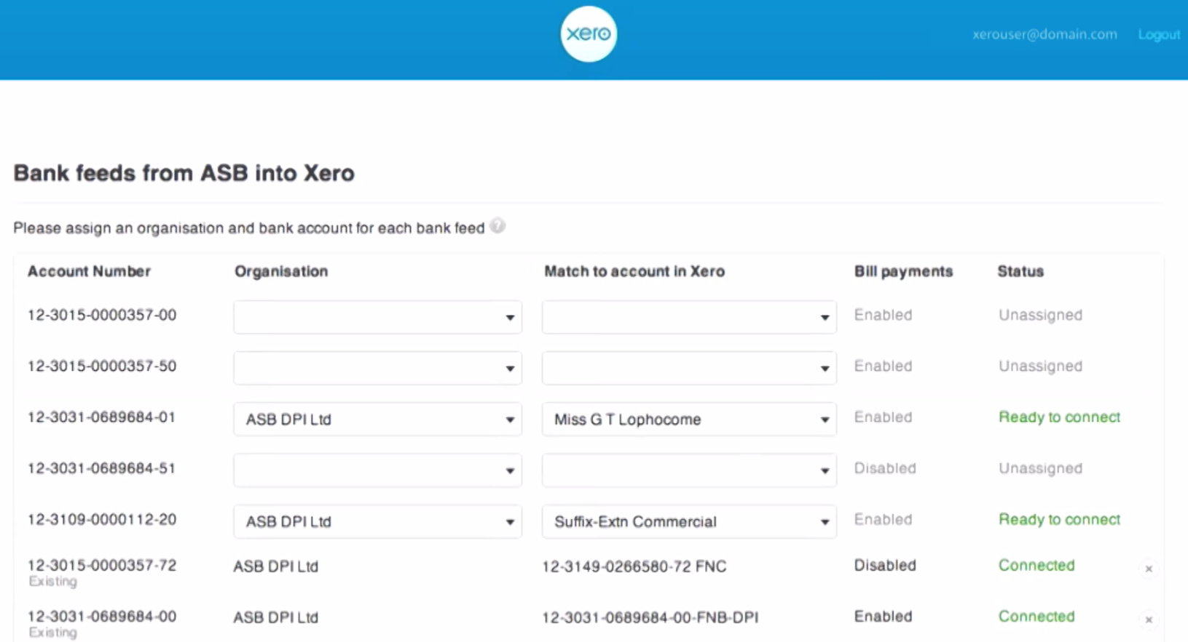
Accounting Set Up - Xero

Slide 7


Slide 8
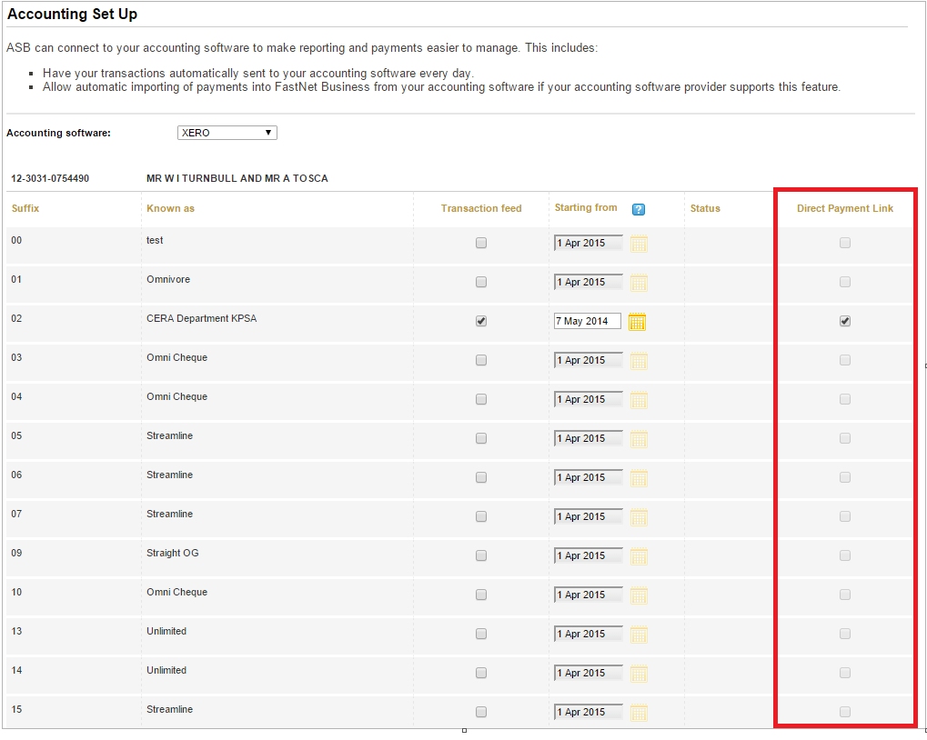
Direct Payment Link – ASB\Xero

Slide 9
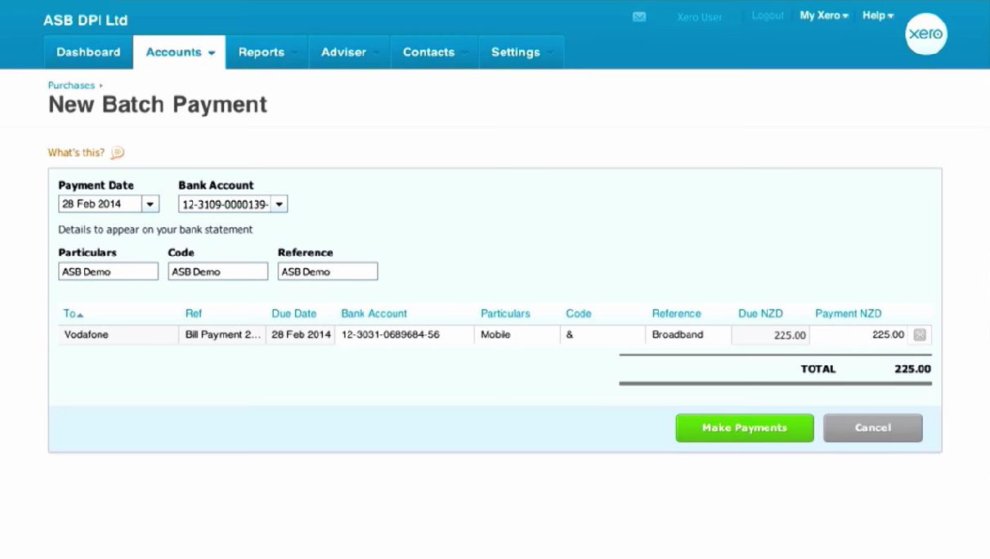
Direct Payment Link – ASB\Xero

Slide 10
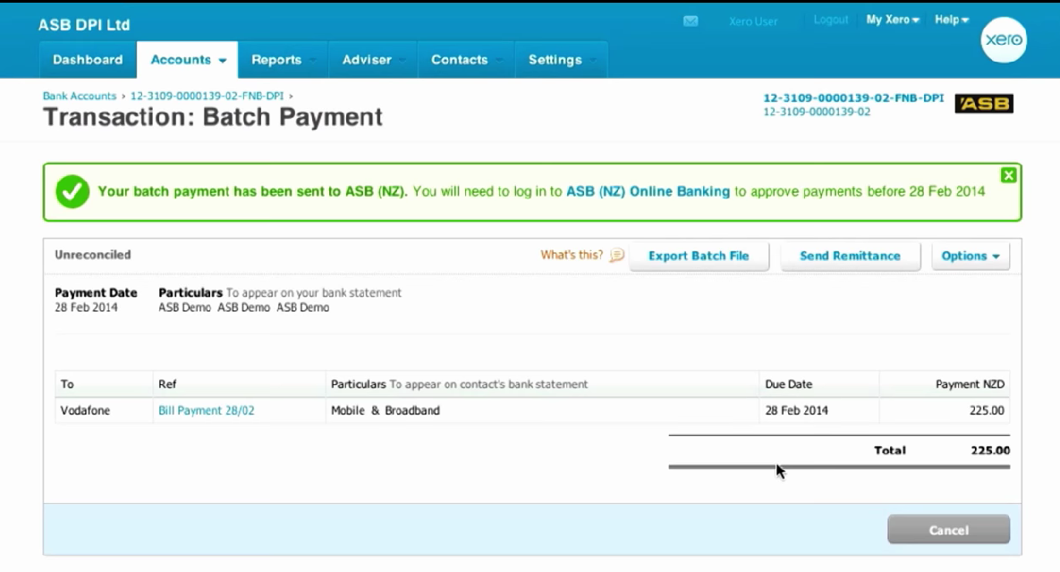
Direct Payment Link – ASB\Xero

Slide 11
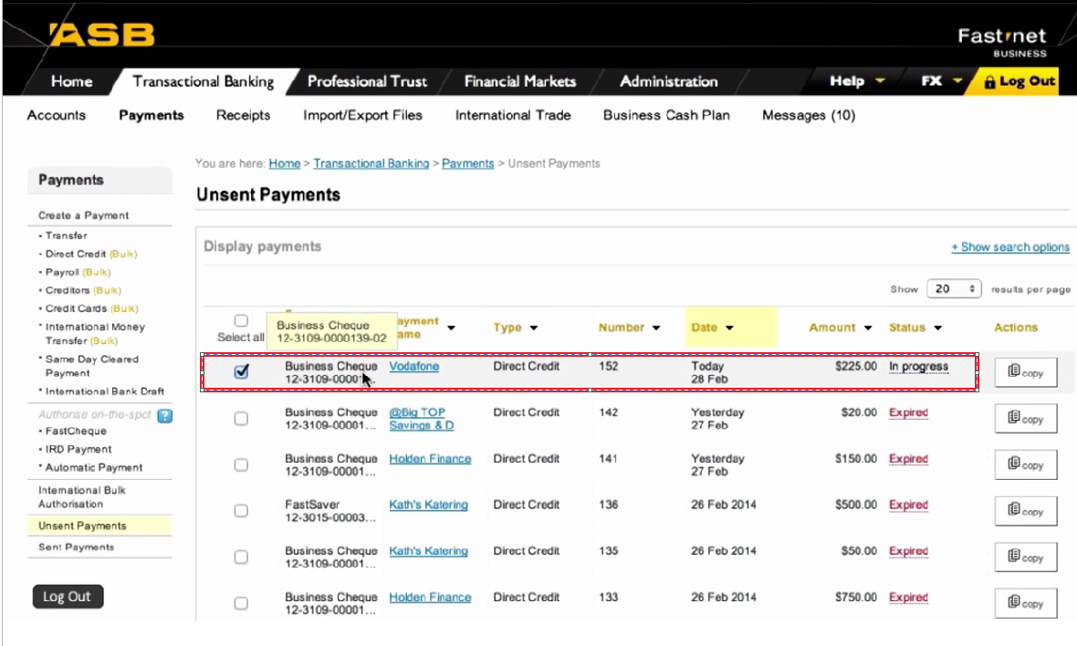
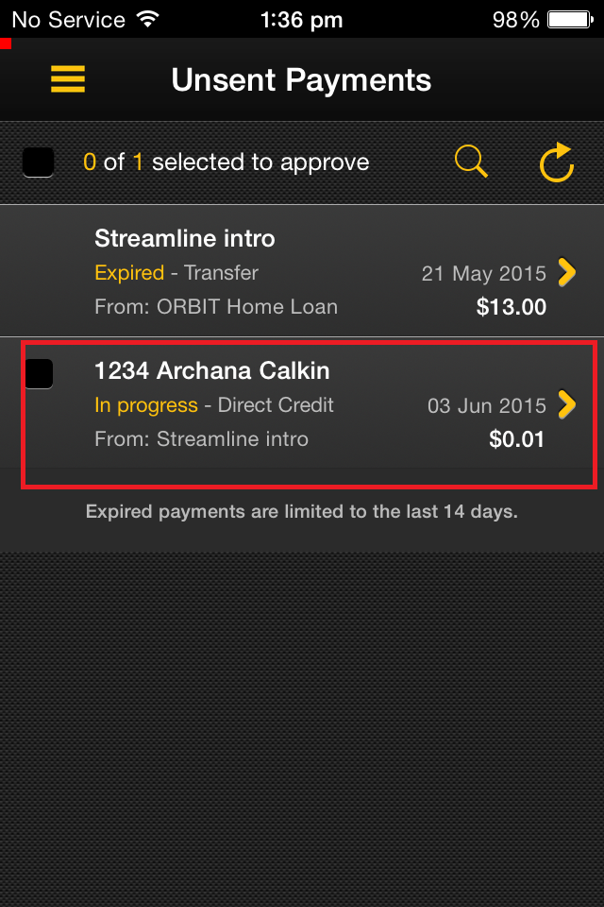
Direct Payment Link – ASB\Xero

Slide 12
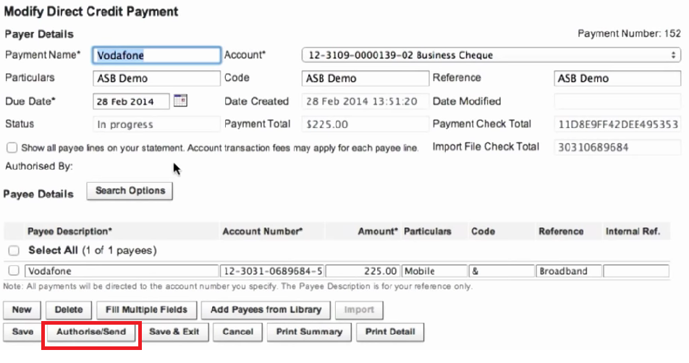
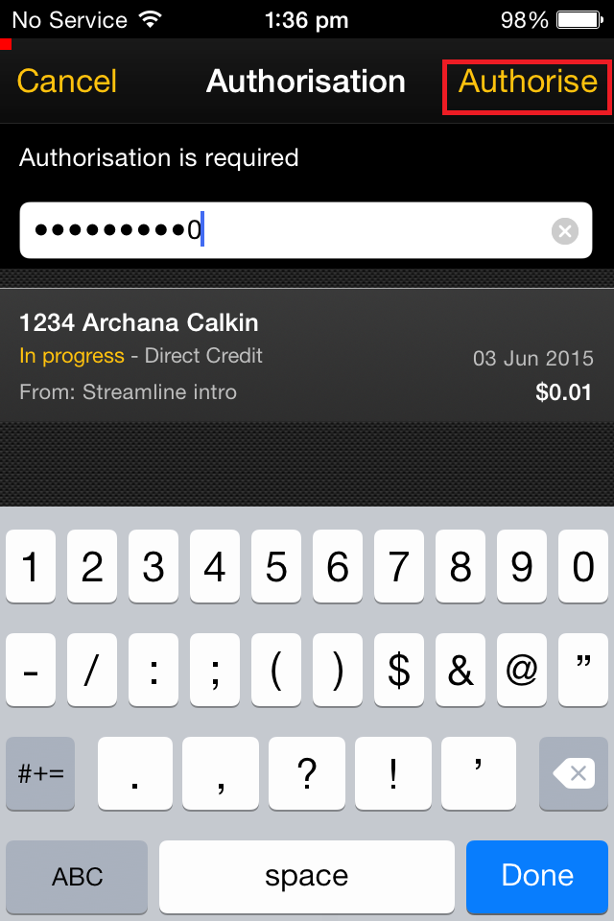
Direct Payment Link – ASB\Xero

Slide 13
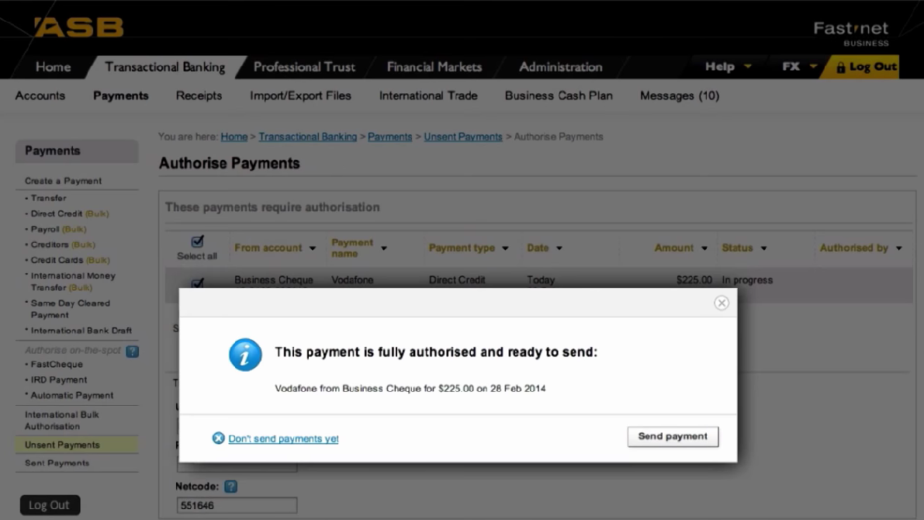
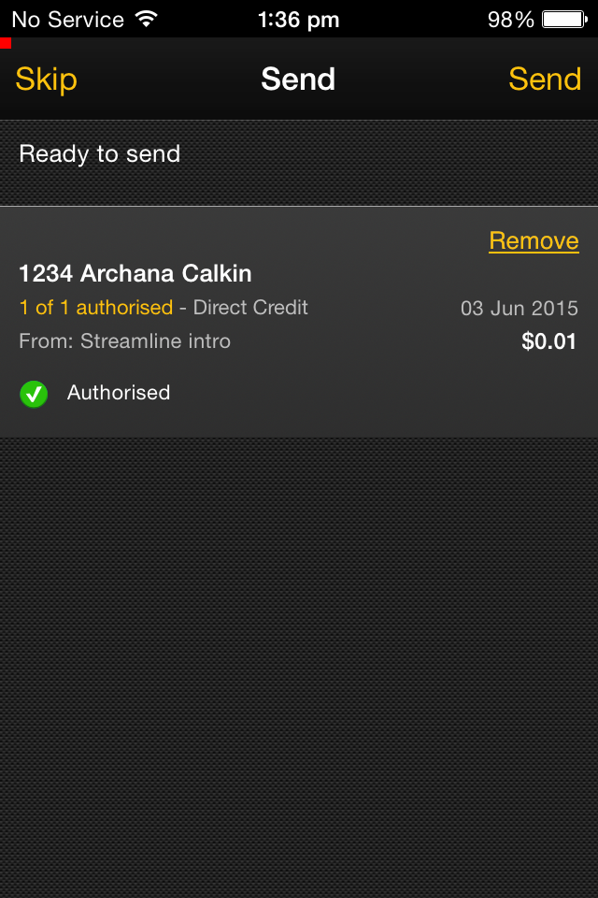
Direct Payment Link – ASB\Xero

Slide 14

“To improve the life of the small business customer”

